Slide 1
Influence-directed Explanations
Anupam Datta
Professor
Electrical and Computer Engineering
Computer Science
Carnegie Mellon University

Slide 2

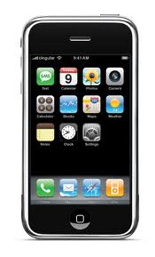
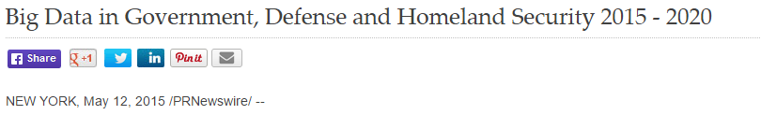
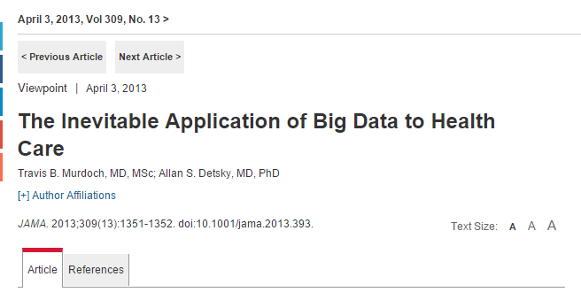
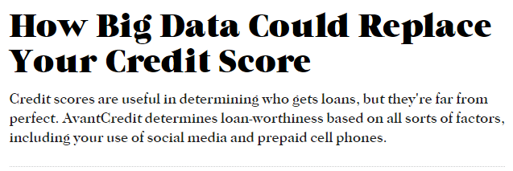
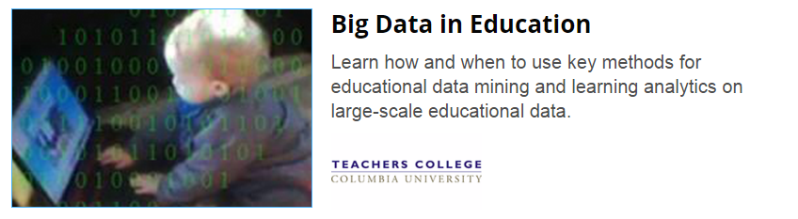


Machine Learning Systems are Ubiquitous
Notes:
Automated data-driven systems that employ machine learning and other artificial intelligence technologies increasingly make decisions that affect our lives.
Which loan or job applications should be approved? How likely is a criminal offender to commit another crime? Does a set of medical images indicate that an individual has cancer? Which advertisements and recommendations should be shown to people as they interact in the digital and physical world?

Slide 3
Machine Learning Systems are Opaque
DR Classifier
?
?
?
Diabetic retinopathy Stage 5
Why this diagnosis from the GoogleNet neural network?

Slide 4


Machine Learning Systems are Opaque
?
Credit
Classifier
?
?
User data
Decisions
Why was Joe denied credit by the tree ensemble model?
Notes:
Yet these systems behave like black boxes – we do not know why they are making these decisions.

Slide 5
Vision: Explainable Machine Learning Systems
Reveal “meaningful information about the logic” of the machine learnt prediction/decision model
Enable humans + machines to make better decisions together
Build trust in and debug models
Guard against societal harms, e.g. unfairness
Comply with regulations, e.g. EU GDPR, US ECOA
Applications: Finance, healthcare

Slide 6
Influence-directed explanations
Explaining property of a ML system =
identify influential factors +
make them human interpretable
Influence: What are important factors causing this model property?
Interpretation: What do these factors mean?

Slide 7
Explaining deep networks [Leino, Sen, Li, Datta, Fredrikson 2018]
Identify causally influential neurons in internal layers
Give them interpretation using visualization techniques

Slide 8
Why classified as sports car instead of convertible?
VGG16 ImageNet model
Input image
Influence-directed Explanation
Uncovers high-level concepts that generalize across input instances
Notes:
Images of cars labeled “sports car” by VGG16 ImageNet
model (a) and receptive fields of the most influential feature map
on a comparative quantity that characterizes the model’s tendency
to predict “sports car” over “convertible” (b). In most cases, the
features within the field contain the top of the car, which is the key
distinctive concept between these classes.

Slide 9
Diabetic retinopathy
Source: American Academy of Ophthalmology
Notes:
People with diabetes can have an eye disease called diabetic retinopathy. This is when high blood sugar levels cause damage to blood vessels in the retina. These blood vessels can swell and leak. Or they can close, stopping blood from passing through. Sometimes abnormal new blood vessels grow on the retina. All of these changes can steal your vision.

Slide 10
Why classified as diabetic retinopathy class 5?
Inception network
Optic disk
Lesions
Notes:
Visualizing the top feature map from the second max pooling layer on correctly predicted stage 5 instances, where the top feature map is determined by taking the sum across the feature maps.

Slide 11
Debugging misclassification of class 2 image
Inception network
Notes:
Preprocessing introduces patches that are regarded as lesions by the network. Mitigated by changing the preprocessing from a Gaussian blur to mean removal.
This image is from the 2nd max pooling layer in the network.

Slide 12
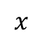
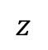


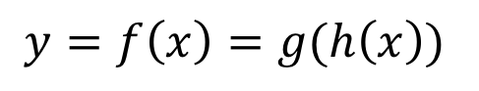
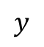
Distributional influence measure
Influence = average gradient over distribution of interest
$$x$$
$$h$$
$$z$$
$$g$$
$$y$$
Gradient <> causal influence
Averaging <> distributional faithfulness
$$y=f\left(x\right)=g(h\left(x\right))$$
Notes:
Unique measure that satisfies a set of natural properties.

Slide 13

Quantitative Input Influence [Datta, Sen, Zick 2016]
Credit
Classifier
Age | 27
Workclass | Private
Education | Preschool
Marital Status | Married
Occupation | Farming-Fishing
Relationship to household income | Other Relative
Race | White
Gender | Male
Capital gain | $41310
…..
Decisions
Negative Factors:
Occupation
Education Level
Positive Factors:
Capital Gain
Notes:
Principal reasons for adverse actions
Gender bias in job-related ads in Google ad ecosystem [Datta et al. 2015]

Slide 14
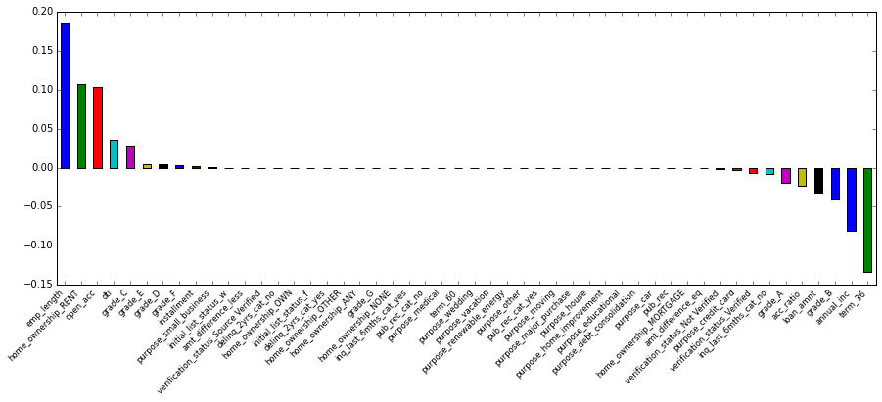
Case study with Lending Club data
Locally linear model
51-variable tree ensembles: scalable, succinct explanations
Most variables aren’t important for any particular individual
ECOA-style
Adverse Action Notice:
Employment Length
Home ownership
Open accounts
DTI
Average number of negative influencers: 4.6
Notes:
All loans issued by Lending Club from 2007-2015
900k data points
75 variables
Build XGBoost models to predict charge-offs

Slide 15
Influence-directed explanations
Explaining property of a ML system =
identify influential factors +
make them human interpretable
Influence: What are important factors causing this model property?
Interpretation: What do these factors mean?

Slide 16
Vision: Explainable Machine Learning Systems
Reveal “meaningful information about the logic” of the machine learnt prediction/decision model
Enable humans + machines to make better decisions together
Build trust in and debug models
Guard against societal harms, e.g. unfairness
Comply with regulations , e.g. EU GDPR, US ECOA
Applications: Finance, healthcare

Slide 17
Thanks!

